Slide 1
Spam Filtering with Naïve Bayes – Which Naïve Bayes?
Vangelis Metsis, Ion Androutsopoulus, Georgios Paliouras
Noopur Kharche – 1001529638
Darshil Parikh - 1001557968

Slide 2
Outline
Introduction - Naïve Bayes
Naïve Bayes Versions
Dataset and Methodology
Experiments and Results
Conclusion

Slide 3
Introduction – Naïve Bayes
Family of simple probability classifiers based on applying Bayes’ theorem with naïve independent assumptions
Statistical method applied by text classification systems
Highly scalable; requires number of attributes in linear with number of variables
Surprisingly effective despite the above mentioned assumptions.
Usually takes “Bag of Words” approach when used with text classification

Slide 4
Naïve Bayes
Puts all tokens into vector of size m
For each instance, a vector <𝑥1, … , 𝑥𝑚> is created where each 𝑥𝑖 is one of two types of values:
1. Term frequency
2. Boolean value

Slide 5


Naïve Bayes
Generally, for a vector x the probability that an instance with vector x belongs in class c is :
In the case of spam filtering, given 𝑐ℎ as ham class, 𝑐𝑠 as spam class, and a threshold T = 0.5, a message is classified as spam when

Slide 6
Naïve Bayes Versions
Multi–Variate Bernoulli NB
Multinomial NB with Term Frequency attributes
Multinomial NB with Boolean attributes
Multi-Variate Gauss NB
Flexible Bayes

Slide 7
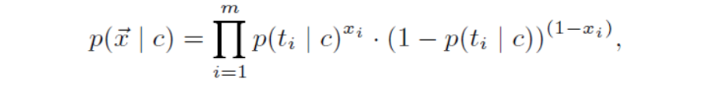
Multi–Variate Bernoulli NB
Treats each message d as a set of tokens (𝑡1, … , 𝑡𝑚).
Each message represented by a binary vector x = (𝑥1, … , 𝑥𝑚), where each 𝑥𝑖 has Boolean value which shows whether 𝑡𝑖 occurs in d or not
Each message seen as a result of m Bernoulli trials, each trial we decide whether 𝑡𝑖 will occur in d or not.
Each p(t|c) estimated using Laplace prior where t is a token

Slide 8

Multinomial NB, Term Frequency Attributes
Treats each message d as a set of tokens (𝑡1, … , 𝑡𝑚).
Each 𝑥𝑖 in each message has a numeric value that states number of times the token occurs in message
Each message picks independently |d| tokens from vector of attributes with probability p(𝑡𝑖|c) for each token
Limitation for spam filtering as it assumes probability of receiving a long spam message is less than receiving equally long ham message.
Additional assumption that the number of tokens chosen does not depend on category

Slide 9
Multinomial NB, Boolean attributes
Same as Term frequency attributes, except the attributes are Boolean
Differs from Multi variate Bernoulli NB as in this case it does not take into account the absence of tokens (𝑥𝑖 = 0) from the message and it uses different Laplacian transform for estimating p(t|c)

Slide 10

Multi-Variate Gauss NB
Modification to Multi variate Bernoulli NB to use real valued attributes by assuming that each attribute follows a Gaussian distribution
Uses normalized TF attributes (TF divided by total number of occurrences in the message)

Slide 11

Flexible Bayes
Instead of using a single normal distribution for each attribute in class, takes p(𝑥𝑖|c) to be average of many normal distributions with different mean values but the same typical deviation
By averaging several normal distributions, fb can approximate the true distributions of real-valued attributes more closely than the multi-variate Gauss NB
Computational Complexity is O(m.N)

Slide 12
Dataset and Methodology
Main concern while generating datasets – to protect the privacy of the users
First approach – To use ham messages collected from freely accessible newsgroups, or mailing lists with public archives
Second approach – Distribute information about each message rather than message itself. Spambase follows this approach.
Third approach – Release benchmarks each consisting of messages received by a user; replacing each token by a unique number
Choose 6 Enron employee email messages; cleaned to only include ham messages

Slide 13
Spam sources
Four different spam sources:
  SpamAssassin corpus
  Honeypot project
  Bruce Guenter spam collection
  Georgois Paliouras spam collection
  First three collected through use of traps
  Removed duplicates from first three and merged first and second
  Duplicates were part of normal traffic stream for fourth source

Slide 14
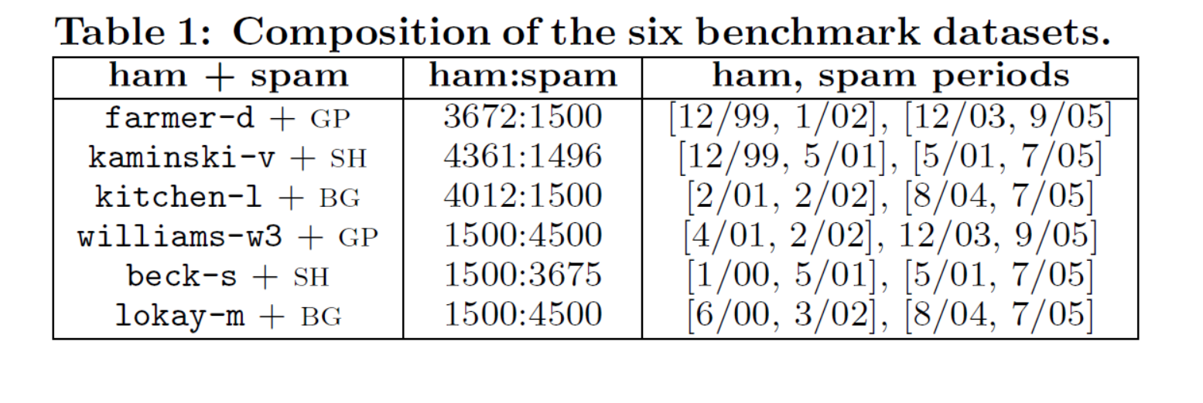
Merged each of the six ham messages with one of the three spam collections
For first three the ham-spam ratio is 3:1, while for the rest three the ratio is 1:3

Slide 15
Pre - Processing
Messages sent by the owner of the mailbox were removed.
All HTML tags and headers of the messages were removed keeping only their subjects and bodies
Spam messages written in non-Latin character sets were removed as the Ham messages were all written in Latin characters
Training the spam filter

Slide 16
Pre – Processing (Continued)
Did not assign attributes to tokens that are too rare
  Discarded tokens that did not occur in at least 5 messages in training data
Ranked remaining attributes by information gain, and used only the m best
Experimented with m = 500, 1000, 3000

Slide 17
Experimental Results
Best results achieved with 3000 attributes
Differences in effectiveness for lower attributes very small
Differences are insignificant across all five versions of NB and for all threshold values
Thus, the increased number of attributes for greater effectiveness may not justify the increased computational cost of the filter, even though the increase is linear.

Slide 18
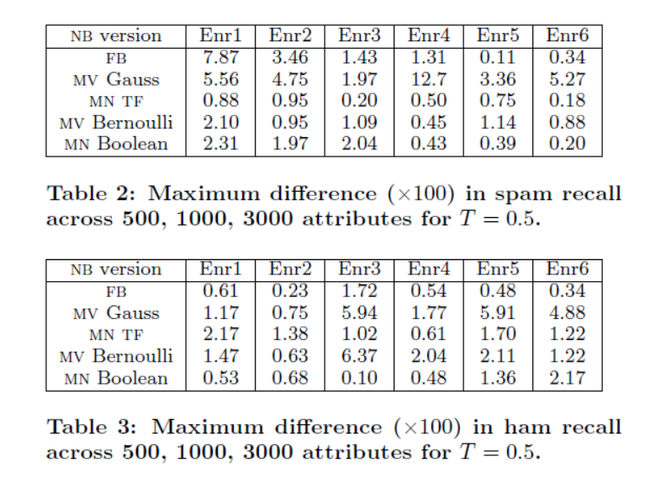

Slide 19
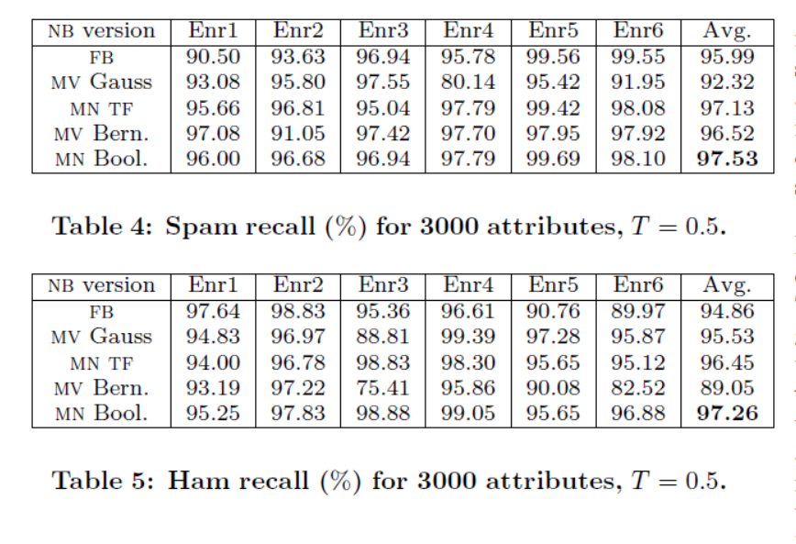
Results (Continued)
Multinomial NB with Boolean attributes performs best in 4 out of 6 datasets
Flexible Bayes performs best in the other 2
Differences in performance between versions of NB typically very Small

Slide 20
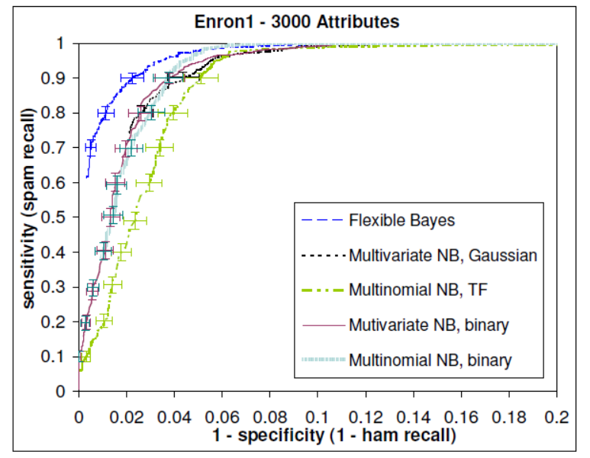

Slide 21
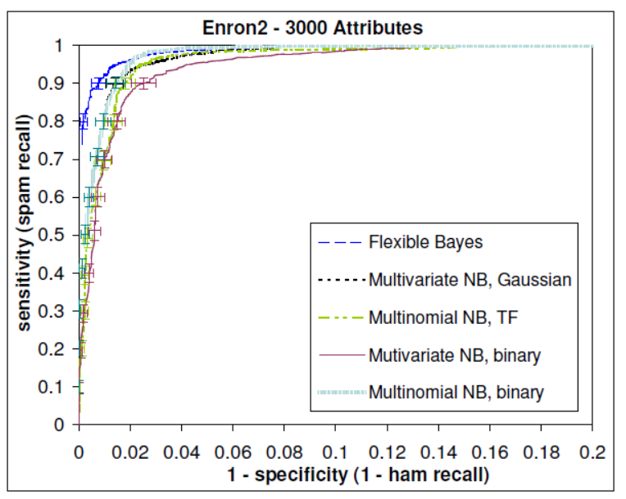

Slide 22
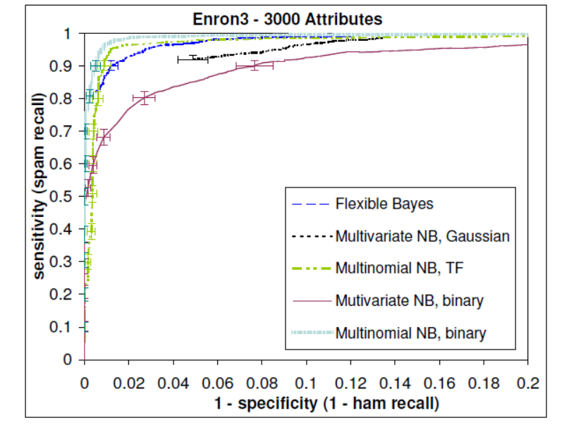

Slide 23
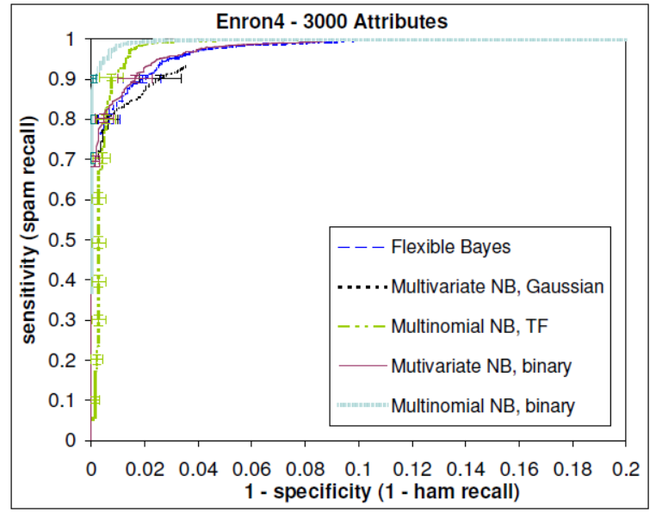

Slide 24
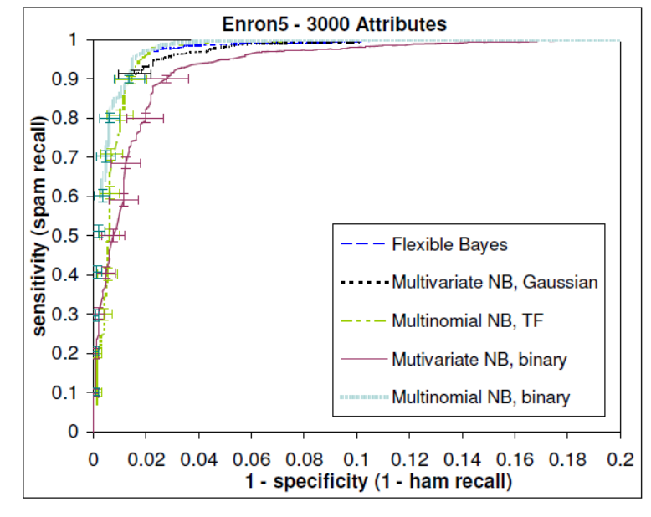

Slide 25
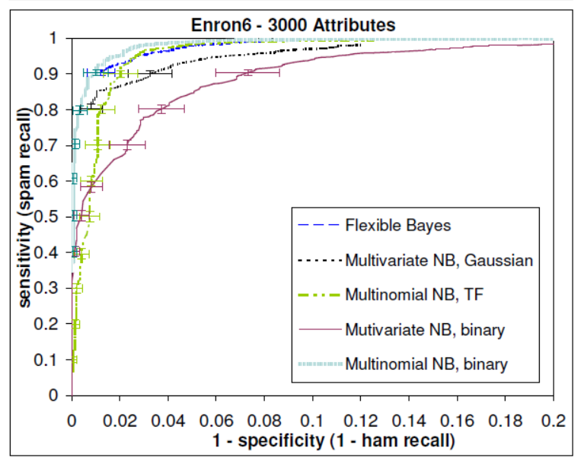

Slide 26
Learning Curve
Provide additional context for the progress made by each classifier over the duration of the experimental runs.
Do not increase monotonically as in other text classification domains.
Most likely due to unpredictable fluctuation of the ham-spam ratio changing topics of spam, and adversarial nature of anti-spam filtering.

Slide 27
Enron1

Slide 28
Enron2

Slide 29
Enron3

Slide 30
Enron4

Slide 31
Enron5

Slide 32
Enron6

Slide 33
Conclusions
The two versions of NB used least in spam filtering i.e. Flexible Bayes and Multinomial NB with Boolean attributes, performed the best in the experiments
Due to lower computational complexity and smoother trade-off between ham and spam recall, the authors tend to prefer Multinomial NB with Boolean attributes.
Best results were achieved with the largest attribute set, but the gain was rather insignificant.

Slide 34
Questions?

